Slide 1
State of our Workforce: Western North Carolina
2022 Survey: Initial Data Results
Michael Hogan
Elizabeth Brown
June 23, 2022

Slide 2
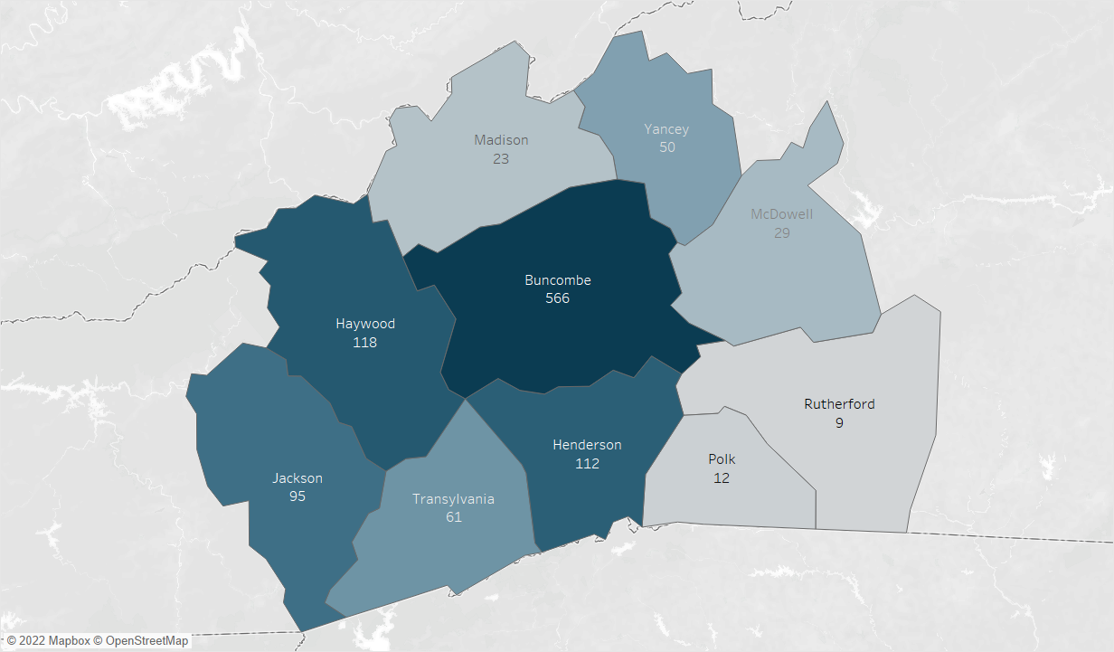
Survey Responses
795 complete & 548 partial responses
All counties represented, with 100+ from Buncombe, Haywood, and Henderson

Slide 3
Respondents Profile
Responses broadly represent the industry mix in the region.
Note that there were cases of multiple respondents from 1,000+ employee organizations such as higher education, public schools/government, and health care employers. We are treating those separately for the sake of this analysis.

Slide 4
Growth Projections
Q: If you expect your workforce to grow, how many new employees do you expect to hire in the next three years?
Across all industries, respondents anticipated a need for between 22,850 and 45,637 new employees in the next three years. These are led by:
Health care
Manufacturing
Public sector
Restaurant, Lodging, and Hospitality
Professional and Technical Services

Slide 5
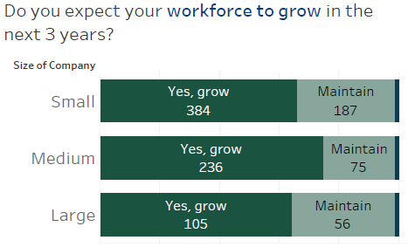
Growth Projections by Company Size
More small companies are anticipating hiring, but large companies anticipate hiring the largest number of employees.
Notes:
More small companies are anticipating hiring, but large companies anticipate hiring the largest number of employees

Slide 6
Credentials and Certificates
Q: What credentials or education experience are you seeking in your future workforce? (select all that apply)
Specific credentials sought in multiple industries
Credential | Industries
Medical Laboratory Technician (MLT) | Life sciences and biosciences; healthcare and social assistance
OSHA 10 Training | Manufacturing; construction and skilled trades
Commercial Driver's License (CDL) | Construction and skilled trades; energy, utilities and clean tech; logistics and warehousing
Licensed Massage Therapist (LMT) | Healthcare and social assistance; restaurant, lodging and hospitality
Six Sigma/Lean Manufacturing | Manufacturing; retail
Master of Public Health (MPH) and Master of Social Work (MSW) | Public sector, education and nonprofit; professional and technical services

Slide 7
Industry-Specific Credentials Please list any industry- or sector-specific degrees or credentials you are seeking in your future workforce.
Industry | Credentials
Construction and skilled trades | Commercial Driver’s License (CDL) North American Technician Excellence (NATE) Certification Journeyman qualifications OSHA 10 training National Wood Flooring Association (NWFA) training Training or experience in construction, HVAC, plumbing, landscaping
Healthcare and social assistance | Nursing credentials like CNA, RN, FNP, bachelor/master’s degree in nursing Emergency medicine: EMPs, paramedics, EMT-B certification Dental professionals: doctoral degrees (DDS, DMD), assistants (CDA), hygienists (RDH) Mental health workers: Relevant master’s degrees and certification (CADC, LCAS, LCSW) Physical therapists with doctoral degrees (DPT), personal trainers (CPT), massage therapists (LMT) Veterinary credentials: doctoral degrees (DVM), technicians (RVT) Radiologic technologists Medical laboratory technicians (MLT) National Alliance for Direct Support Professionals (NADSP) Certification
Notes:
Certified Nursing Assistant (CNA)
Certified Alcohol and Drug Counselor (CADC), Licensed Clinical Addiction Specialist (LCAS), Licensed Clinical Social Worker (LCSW)

Slide 8
Industry-Specific Credentials (continued) Please list any industry- or sector-specific degrees or credentials you are seeking in your future workforce.
Industry | Credentials
IT, software, and analytics | Bachelor’s degree in computer science or related CompTIA Certification EC-Council Certified Ethical Hacker SANS Institute trainings SOC Analyst Certification
Manufacturing (includes food, beverage and product manufacturing and distribution) | Machinist degrees (associate’s) Mechatronics degrees (Bachelor’s or Master’s) Plastics Technology and Engineering Certificate Lean Manufacturing/Six Sigma training OSHA 10 training Culinary Arts degree or certificate Acidified Food Manufacturing training Experience in manufacturing
Notes:
Certified Nursing Assistant (CNA)
Certified Alcohol and Drug Counselor (CADC), Licensed Clinical Addiction Specialist (LCAS), Licensed Clinical Social Worker (LCSW)

Slide 9
Industry-Specific Credentials (continued) Please list any industry- or sector-specific degrees or credentials you are seeking in your future workforce.
Industry | Credentials
Professional and technical services | Engineering, architecture and surveying Associate’s or Bachelor’s in geomatics, surveying or related Bachelor’s in architecture, geology Master’s or doctoral degree in engineering or physics Professional Engineering License LEED accreditation Bachelor’s degree or experience in finance; real estate licensure Master of Public Health (MPH) or Master of Social Work (MSW) degree Society for Human Resource Management (SHRM) Certification FAA Pilot Certification JD degree
Public sector, education and nonprofit | Education: Bachelor’s degree in education or early childhood education; BK Teaching License (Birth through Kindergarten) Bachelor’s, master’s or doctoral degree in human services, social sciences, and related fields Master of Public Health (MPH) or Master of Social Work (MSW) degree Bachelor's degree in parks, recreation or related fields Master's degree in Arts Administration Community Health Worker (CHW) Training HUD Housing Counseling Certification Wilderness First Responder training
Notes:
Certified Nursing Assistant (CNA)
Certified Alcohol and Drug Counselor (CADC), Licensed Clinical Addiction Specialist (LCAS), Licensed Clinical Social Worker (LCSW)

Slide 10
Industry-Specific Credentials (continued) Please list any industry- or sector-specific degrees or credentials you are seeking in your future workforce.
Industry | Credentials
Restaurant, lodging and hospitality services | Associate's degree in Baking, Pastry Arts, Culinary Arts Cicerone Certification ServSafe Food, Alcohol Certificate Licensed Massage Therapists (LMT) Experience in administration, business, marketing Experience in restaurants and event planning Experience in snowmaking, ski lodges
Retail | Experience in retail, business and marketing Specific experience with: quilting or sewing, medicinal herbs, professional driving, arts and ceramics Six Sigma Certification Motorcycle mechanic training
Notes:
Certified Nursing Assistant (CNA)
Certified Alcohol and Drug Counselor (CADC), Licensed Clinical Addiction Specialist (LCAS), Licensed Clinical Social Worker (LCSW)

Slide 11
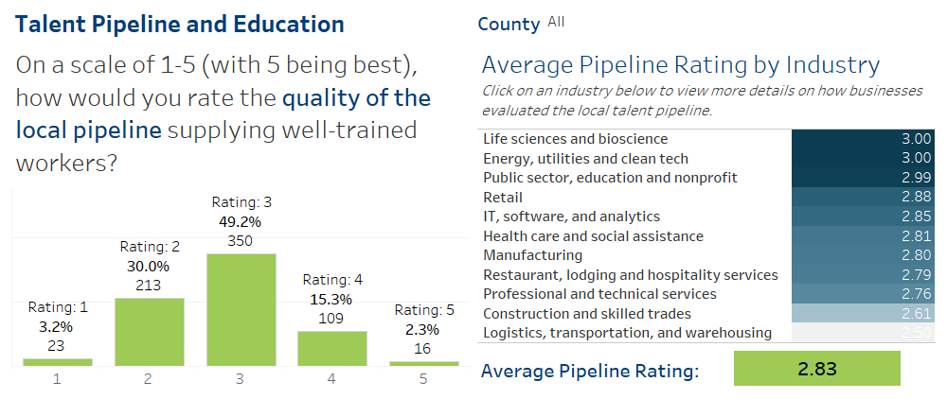
Talent Pipeline Evaluation

Slide 12
Challenges and Obstacles

Slide 13
Challenges and Obstacles: Housing “As you look to the future, what concerns or final thoughts do you have about the state of the local workforce?”
Mentioned by 67 respondents
Housing affordability was the most frequently mentioned concern. Respondents noted the link between this issue and wages, transportation, and other challenges.
Example responses
"The housing market is too expensive for employees to make ends meet. We've bumped up wages, but can't keep up with the rent increases."
"The housing market is a joke. It is hard to recruit when the only living option is to 1) live in a hotel until something comes up 2) live in an apartment complex full of college students or 3) buy a double-wide trailer for $200K. Options are slim."
"AFFORDABLE HOUSING, AFFORDABLE HOUSING, AFFORDABLE HOUSING!"

Slide 14
Challenges and Obstacles: Lack of workers “As you look to the future, what concerns or final thoughts do you have about the state of the local workforce?”
Mentioned by 66 respondents
Many respondents noted that the demand for workers far outstrips the supply. Job postings receive few applications, turnover is very high, and competition for available workers is strong.
Example responses
"We do not have the numbers available to fill the numbers of open jobs, which may ultimately lead to companies shutting down or relocating if they are able because they are unable to operate in our area."
"With the unemployment rate being extremely low, and the addition of so many new businesses, existing businesses are concerned over how anyone of us can ever be fully staffed."
"The demand for entry level workers is much higher than the community's ability to attract and sustain them. We are way off-balance. Our entry-level workers can't afford to live here."

Slide 15
Challenges and Obstacles: Wages “As you look to the future, what concerns or final thoughts do you have about the state of the local workforce?”
Mentioned by 64 respondents
With increasing cost of living and strong competition for workers, employers must offer higher and higher wages to attract applicants.
Example responses
"We raise our prices to continue to pay a living wage that nobody can still live off."
"The skill is there in the labor pool. A person with these valuable skills willing to take the salary we can afford to pay is what is hard to find."
"We pay far above average for our industry, but it still isn't enough to allow people to live in this area. Cost of living and the complete lack of affordable housing is the number one problem."

Slide 16
Challenges and Obstacles: Cost of living “As you look to the future, what concerns or final thoughts do you have about the state of the local workforce?”
Mentioned by 58 respondents
Along with wages and housing, cost of living in Western NC was a frequently mentioned challenge.
Example responses
"I feel Western North Carolina has no shortage of eager folks looking to work, but cost of living and affordable housing options are huge barriers to retaining good talent in the region."
"In the past 6 months, I have lost 2 employees due to the living expenses in Asheville. They have relocated to other cities."
"The cost of living in Asheville is so high that the pay rates need to go way up in order for staff to afford to live here. For pay to go up, our prices need to go up and it's getting to the point where our costs are so high that it's turning customers away."

Slide 17
Challenges and Obstacles: Childcare “As you look to the future, what concerns or final thoughts do you have about the state of the local workforce?”
Mentioned by 19 respondents
Respondents note that options for childcare are few and often prohibitively expensive. Without reliable childcare, staff struggle to attend work reliably, and often need to relocate or leave the workforce entirely.
Example responses
"Housing, childcare and wages are top of the list for challenges. We have a hard time attracting long-term employees because they do not see a future for themselves in our county...Childcare? Forget about starting a family in this county AND having a full time job."
"Childcare needs to be subsidized so it's affordable for workers. Strong early child education paves the way for children to enter the workforce educated."
"Childcare options are all but non-existent, adding further stressors to new parents or new employees moving in with families."

Slide 18
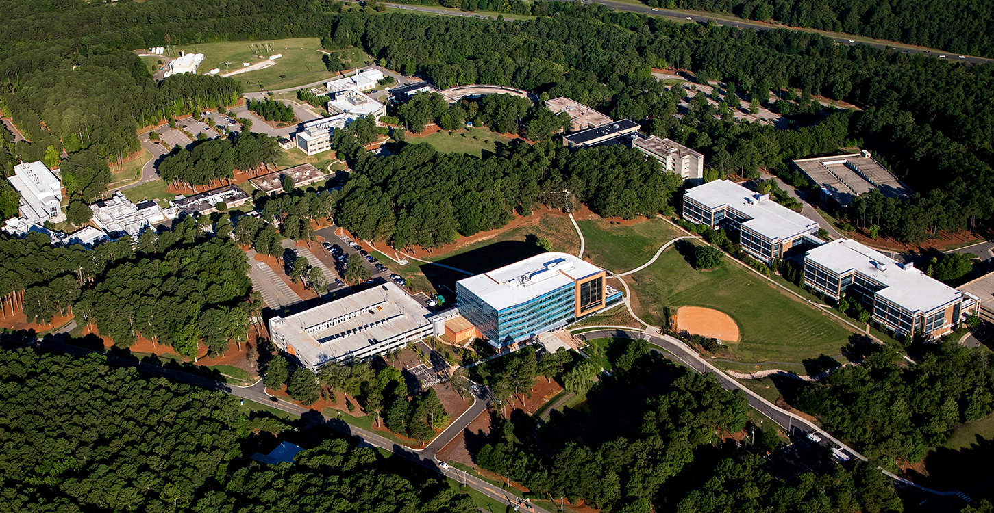
Thank you
Contact: Michael Hogan, Elizabeth Brown | email: mhogan@rti.org

Slide 19
Growth Projections by Company Size

Slide 20
Challenges and Obstacles: Internet infrastructure “As you look to the future, what concerns or final thoughts do you have about the state of the local workforce?”
Mentioned by 5 respondents
Respondents believe improved availability of high-speed internet in the region would help recruit and retain workers, and enable increased remote work.
Example responses
"The lack of a good internet infrastructure is probably the biggest issue currently and going forward."
"Access to residential internet. And not just any internet provided like Frontier. Dependable and fast internet like with Skyfi, Morris Broadband, etc."

Slide 21
Challenges and Obstacles: Transportation “As you look to the future, what concerns or final thoughts do you have about the state of the local workforce?”
Mentioned by 16 respondents
Coupled with housing challenges, employers note that staff have fewer and fewer options for getting to their workplace. Being unable to afford housing close to work, and without adequate public transit options, they are faced with high gas prices, car maintenance costs, time stuck in traffic, and difficulty parking.
Example responses
"Employees and potential workers are having to live further and further from this workplace. Public transport is non-existent in western NC, and it's becoming impossible to earn enough to justify driving to work. Something needs to give, or my organization will further advance into this crisis of attracting talent."
"Our staff skews young, and they are being driven further out due to rising housing costs. Then they have to deal with increased transportation costs, time in traffic, and, because we're located downtown - difficulties finding and paying for parking.

Slide 22
Challenges and Obstacles: Social climate and diversity “As you look to the future, what concerns or final thoughts do you have about the state of the local workforce?”
Mentioned by 8 respondents
Employers noted a lack of cultural and racial diversity in the area that they perceive to be hurting their recruitment and retention efforts.
Example responses
"Lack of visible racial balance and equity means that we do not attract all people of talent."
"There is a lack of diversity that meets the cultural needs of people of color or other backgrounds in the industry."

Slide 23
Challenges and Obstacles: Regional focus on tourism “As you look to the future, what concerns or final thoughts do you have about the state of the local workforce?”
Mentioned by 13 respondents
Multiple respondents feel that the region's focus on being a tourist destination must be balanced with permanent residents' ability to live comfortably. In particular, many perceived that the region's housing market challenges are exacerbated by the number of hotels, investor-purchased properties, and short-term rentals like AirBNBs.
Example responses
"Brevard has no affordable housing. So many homes have turned into AirBNBs, leaving locals out in the cold."
“To bring in highly skilled IT professionals, it would be useful if WNC advertised itself as a center for science and technology, as well as Beer City.”
"I am concerned because we live in a "destination" area in WNC. The cost of living is substantially more here, yet we seem to struggle to get resources that we need to recruit and retain qualified skilled talent."

Slide 24
Challenges and Obstacles: Workplace and management issues “As you look to the future, what concerns or final thoughts do you have about the state of the local workforce?”
Mentioned by 7 respondents
Some respondents feel that employers will need to improve management practices and offer employees more flexibility and respect in order to retain them in a competitive labor market.
Example responses
"…a prime reason for leaving a job is a bad boss. We must put more effort into selecting and training supervisors."
"Burn out and low wages are problematic. All this goes back to too much work for too little pay. It's creating high stress and sometimes toxic environments. Why stay when there are other jobs?"
"Treat your employees like the professionals they are, and trust them to be productive when working from home or in a flexible schedule."

